Slide 1
Sprint #2 Review
IGVC
AutoMav

Slide 2
Sprint metrics
Item | Estimated Time | Actual Time
Product Concept | 2 | 2
Product Description | 2 | 2
Customer Requirements | 8 | 6
Packaging Requirements | 2 | 1.5
Performance Requirements | 4 | 2
Safety Requirements | 3 | 2
Maintenance Requirements | 2 | 1
Future Requirements | 1 | 0.5
Other Requirements | 1 | 0.1
Total time | 25 | 17.1

Slide 3
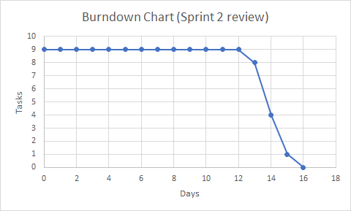
Sprint Metrics Continued

Slide 4
Outside sprint changes
Decided name to be “Automav”
2019 rules were released with slight changes

